Slide 1

Team SEWZ: Project report
Shouyu Ling, Eric Chang, Wei Shao, Zorry Belchev

Slide 2
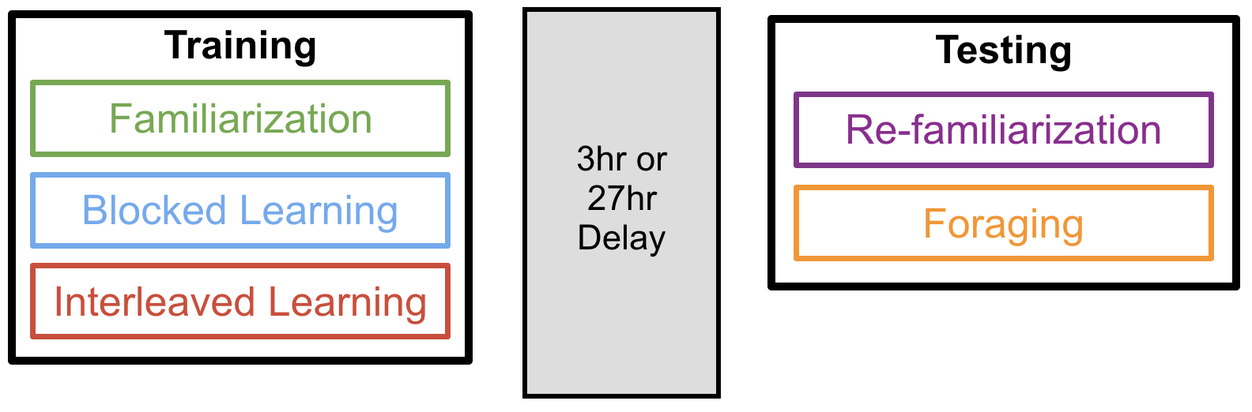
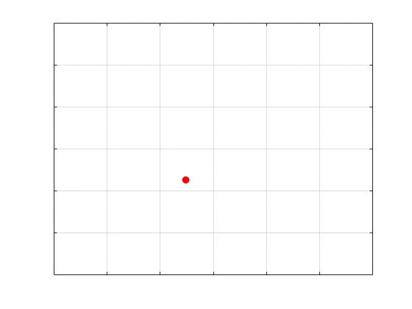
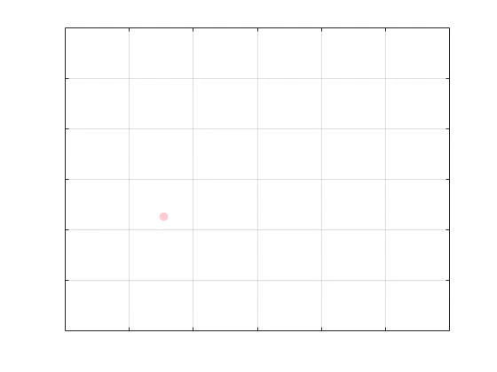
Experiment overview: Training Phase
Blocked Learning
Interleaved Learning

Slide 3
Experiment overview: Training Phase

Slide 4
Predict performance on Block 3
Regression model based on invisible trials
Block 3 Performance
Block 2 Performance
Environment Type
Rural
Urban
Reward Type
Food
Water
Money

Slide 5
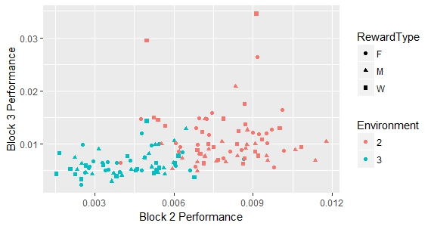
Predict performance on Block 3
Regression model : Results
REML criterion at convergence: -1079.9
Variable | F | p
Block2Performance | 0.69 | .41
Environment | 13.87 | .0003
RewardType | 2.12 | .12
Rural
Urban

Slide 6
Predict performance on Block 3
Follow-up analysis separated by environment
Block 3 Performance
Block 2 Performance
Environment Type
Rural
Urban
Reward Type
Food
Water
Money

Slide 7
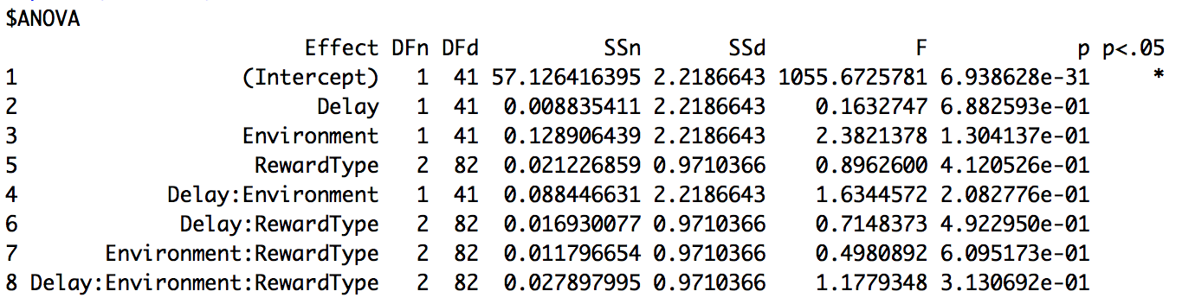
Three-way mixed-design ANOVA
Dependent variable: Bhattacharyya Coefficient
Independent variables:
Between-subject: Delay (Short, Long) and Environment (Rural, Urban)
Within-subject: Reward Type (Food, Water, Money)

Slide 8
Effect of the environment
Environment
Rural
Urban

Slide 9
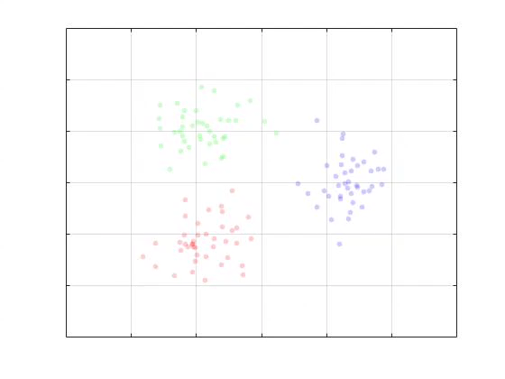
Example: A Good Subject

Slide 10
Example: A Good Subject

Slide 11
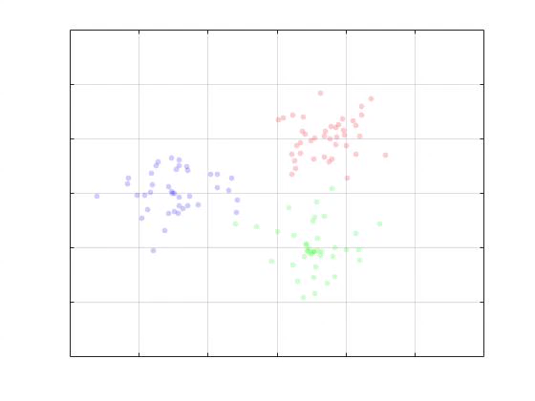
Example: A Bad Subject

Slide 12
Example: A Bad Subject

Slide 13
Predict Testing Performance
Number of rewards found during the training
r = .62, p < .001

